Slide 1
DB EXAM
REVIEW

Slide 2
GROUP BY

Slide 3
Question 1
Consider the following schema:
Orders(customer, order_date, order_price)
Select the SQL statement that best implements the following query
"The sum of all orders per customer"

Slide 4
"The sum of all orders per customer"
Orders(customer, order_date, order_price)
SELECT customer, SUM(order_price) FROM Orders GROUP BY customer
SELECT customer, order_date, SUM(order_price) FROM Orders GROUP BY customer
SELECT customer, order_date, SUM(order_price) FROM Orders GROUP BY order_price
SELECT customer, order_date, SUM(order_price) FROM Orders GROUP BY order_date

Slide 5
Question 2
Consider the following schema:
Orders(oid (pk), pid (fk), order_date) Products(pid (pk), name)
Select the statement that best implements the following query
"How many orders per product"

Slide 6
"How many orders per product"
Orders(oid (pk), pid (fk), order_date); Products(pid (pk), name)
SELECT o.pid, COUNT(o.oid) FROM Orders o GROUP BY o.pid
SELECT o.pid, COUNT(o.pid) FROM Orders o GROUP BY o.pid
SELECT o.pid, o.order_date, COUNT(o.oid) FROM Orders o GROUP BY o.pid
SELECT o.pid, o.order_date, COUNT(o.oid) FROM Orders o GROUP BY o.pid

Slide 7
Question 3
Consider the following schema:
Students(sid (pk), graduating_year, mid (fk)) Majors(mid (pk), major_name)
Select the statement that best implements the following query
"What are min and max graduation year, per major"

Slide 8
"What are min and max grad year, per major"
Students(sid, graduating_year, mid); Majors(mid, major_name)
SELECT s.mid, min(s.graduating_year), max(s.graduating_year) FROM Students s GROUP BY s.mid
SELECT s.mid, min(s.graduating_year), max(s.graduating_year) FROM Students s GROUP BY s.graduating_year
SELECT s.mid, min(s.graduating_year), max(s.graduating_year) FROM Students s WHERE s.graduating_year >= min(graduating_year) AND s.graduating_year <= max(graduating_year) GROUP BY s.graduating_year
SELECT s.mid, m.major_name, min(s.graduating_year), max(s.graduating_year) FROM Students s, Majors m WHERE s.mid = m.mid GROUP BY s.mid

Slide 9
GROUP BY Q4
Referring to the UML class diagram in the handout labeled School Database. Select statements that best implements the following query. Assume course titles are unique.
"Which student(s) got the highest grade in a course titled CS1234 in the semester of Spring 2345. List the student's id, first name, last name, and final grade"

Slide 10
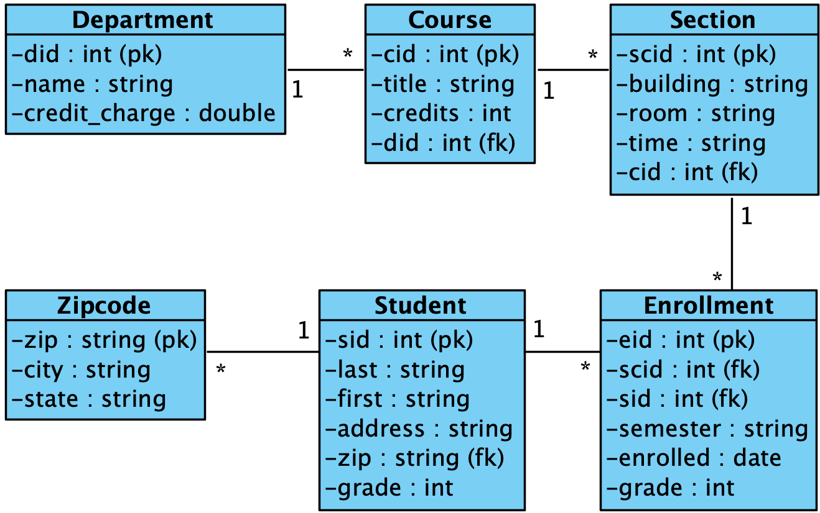
School Database

Slide 11
GROUP BY Q4
Which student(s) got the highest grade in a course titled CS1234 in the semester of Spring 2345. List the student's id, first name, last name, and final grade"

Slide 12
select st.sid, st.first, st.last, st.grade from Students st where s.grade = (select max(e.grade) from Enrollments e, Sections s, Courses c, Students st where e.scid = s.scid and s.cid = c.cid and st.sid=e.sid and c.title='CS1234' and e.semester=Spring 2345 group by s.scid)
select s.sid, s.first, s.last, s.grade from Students s where s.grade = (select max(e.grade) from Enrollments e, Sections s, Courses c where e.scid = s.scid and s.cid = c.cid and c.title='CS1234' and e.semester=Spring 2345)

Slide 13
select s.sid, s.first, s.last, s.grade from Students s where s.grade = (select max(e.grade) from Enrollments e, Sections s where e.scid = s.scid and s.cid = Courses.cid and Courses.title='CS1234' and e.semester=Spring 2015' group by Courses.cid)
select s.sid, s.first, s.last, s.grade from Students s where s.grade = (select max(e.grade) from Enrollments e, Courses c where e.scid = Sections.scid and Sections.cid = c.cid and c.title='CS1234' and e.semester=Spring 2015' group by Sections.scid)

Slide 14
Question 4
Based on the Airline database, write a SQL query to calculate how many reservations were made with the Quatar Airways flights for a cost higher than the average cost of all Quatar’s reservations? Note that the cost of a reservation is the sum of the price of all tickets in that reservation. Only list the total number of reservations. Rename the calculated field 'NumReservations>AvgForQA'

Slide 15
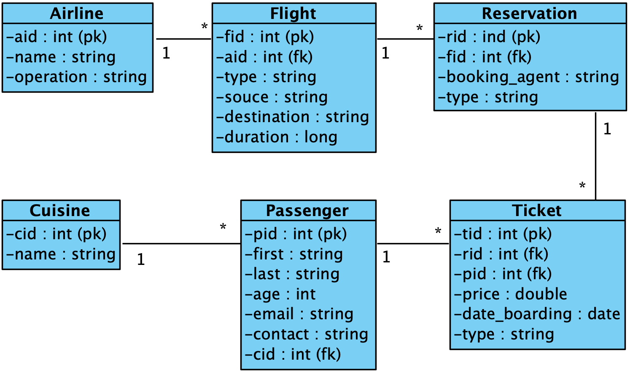
Airline Database

Slide 16
NORMALIZATION

Slide 17
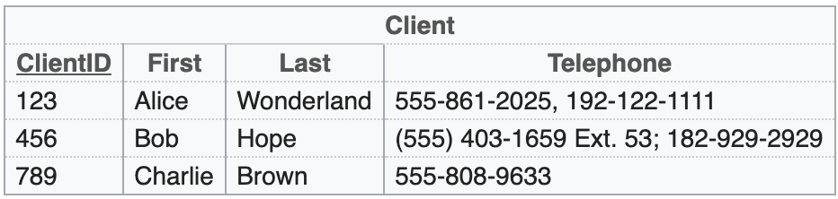
Consider the following table
Which of the following options is the BEST way to capture the same information?
Note: Primary keys are underlined and foreign keys are underlined and italic and named as the primary key they refer to

Slide 18
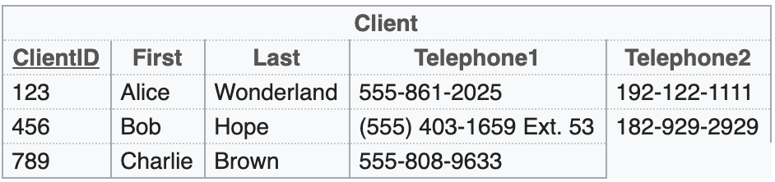
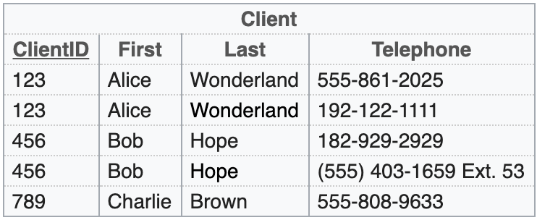
A
B

Slide 19
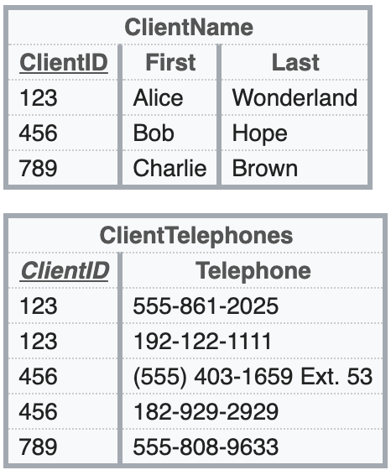
C

Slide 20
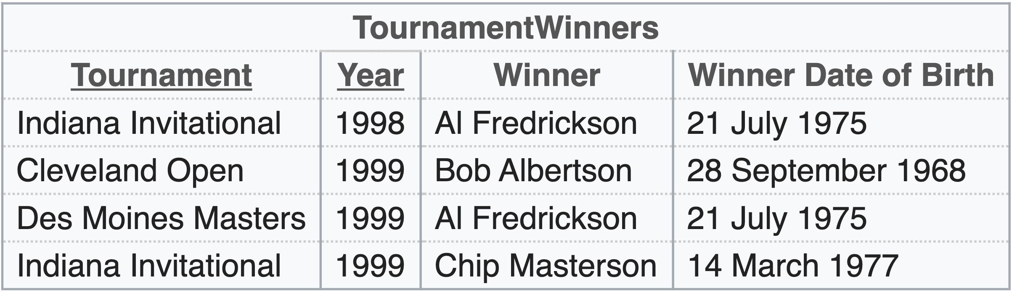
Consider the following table where the first two columns make a composite primary key
Which of the following options is the BEST representation of the same data?

Slide 21
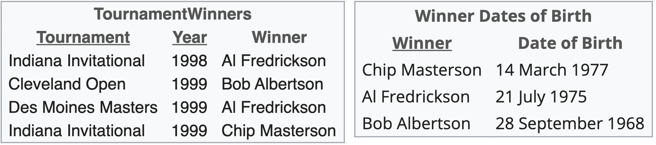
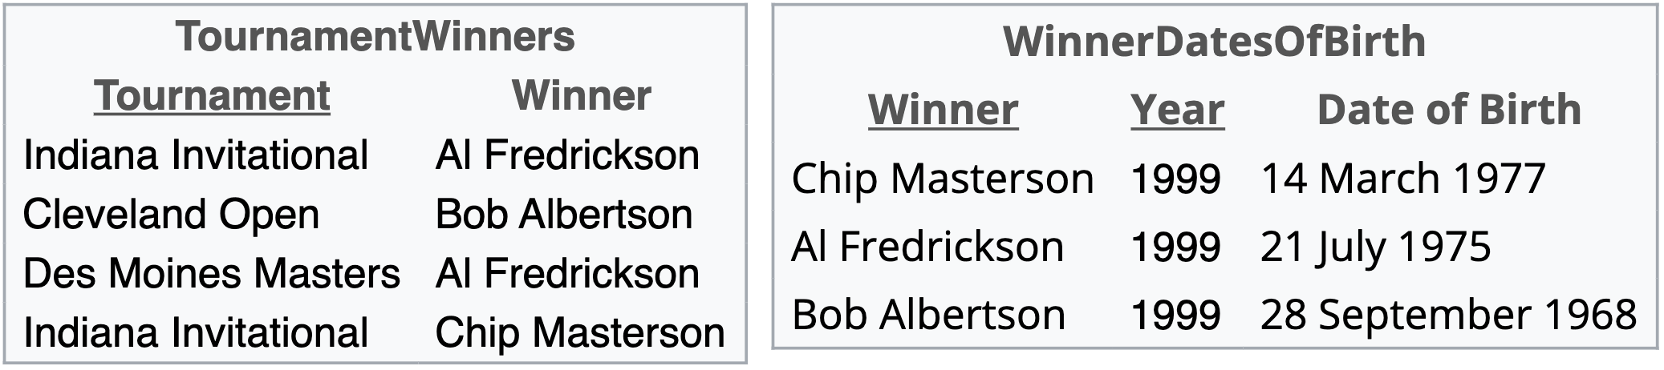
A
B
C A & B
D None of these

Slide 22
RELATIONAL
ALGEBRA

Slide 23
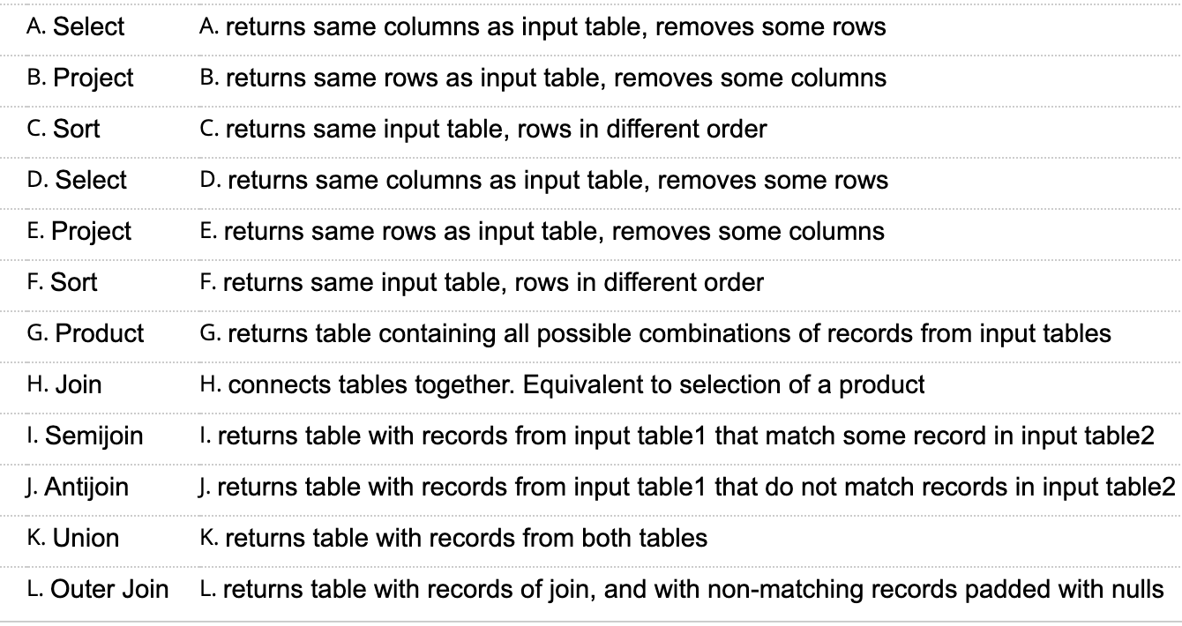
Question 1

Slide 24
Question 2
Consider the following schema
Employee(eid, name, pid)
Project(pid, name)
What does the following query return?
select(project(Employee, {name}), pid=10)
Note: Primary keys are bold, foreign keys are italic and have same name as primary key they refer to

Slide 25
Question 2
The query is meaningless, therefore the query returns nothing
The names of employees assigned to project whose pid=10
The names of employees concatenated with the names of project whose pid=10
The inner project is meaningless, therefore the query just returns the project whose pid=10

Slide 26
Question 3
Consider the following schema
Employees(sid, name, hiring_year, pid)
Projects(pid, name)
What does the following expression mean?
π_{name}(σ_{pid=10^hiring_year=2004}(Employees))

Slide 27
Question 3
Retrieve employee names of employees assigned to pid=10 and hired in 2004
Retrieve project names of employees assigned to pid=10 or hired in 2004
Retrieve employee names for projects whose pid=10 and hired in 2004
Retrieve project names for employees whose pid=10 or graduating in 2004

Slide 28
JOINS

Slide 29
Question 1
Consider the following schema
Stock(sid (pk), name, type, price)
Transaction(tid (pk), pid (fk), sid (fk), type, unit, number, date)
Portfolio(pid (pk), name, owner, beneficiary)
Select the statement that best implements the following query
“All the technology stocks owned by John”

Slide 30
Question 1
select s.* from stock s, transaction t, portfolio p where s.sid=t.sid and t.pid=p.pid and s.type=‘technology’ and p.owner=‘John’
select s.* from stock s, transaction t, portfolio p where s.sid=t.tid and t.tid=p.pid and s.type=‘technology’ and p.owner=‘John’
select s.* from stock s, portfolio p where s.type=‘technology’ and p.owner=‘John’
select s.* from stock s, portfolio p where s.sid=Transaction.sid and Transaction.pid=p.pid s.type=‘technology’ and p.owner=‘John’

Slide 31
Question 2
Consider the following schema
Passenger(pid (pk), name, age)
Reservation(rid (pk), booking_agent)
Ticket(tid (pk), pid (fk), rid (fk), price, date)
Select the statement that best implements the following query
“All the names of senior passengers booked by Alex”

Slide 32
Question 2
select p.name from Passenger p, Reservation r, Ticket t where p.pid=t.pid and t.rid=r.rid and p.age>=65 and booking_agent=‘Alex’
select p.name from Passenger p, Reservation r, Ticket t where p.pid=t.tid and t.tid=r.rid and p.age>=65 and booking_agent=‘Alex’
select p.name from Passenger p, Reservation r, Ticket t where p.pid=t.tid and t.tid=r.rid and p.age>=65 and booking_agent=‘Alex’
select p.name from Passenger p, Reservation r, Ticket t where p.pid=t.tid and t.tid=r.rid and p.age>=65 and booking_agent=‘Alex’

Slide 33
DAOs

Slide 34
Question 1
Data access object is a design pattern that provides an interface to some type of database or other persistence mechanism.
True
False

Slide 35
Question 2
It is often a good idea to have multiple instances of the same data access object type in an application.
True
False

Slide 36
Question 3
Which of the following best defines a data access object?
a design pattern that provides an interface that encapsulates interactions with a database
a design pattern that automatically maps an object instance to a record in a database
a design pattern that controls access privileges to data stored in a database
an object instantiated from a record in a database

Slide 37
Question 4
Usually we create a data access object for every _____________
Table
Field
One to many relation
Inheritance relation

Slide 38
Question 5
What other design pattern is often used with data access objects?
Singleton pattern
Prototype pattern
Adapter pattern
Composite pattern

